Slide 1
POWERBI
- BY REETA

Slide 2
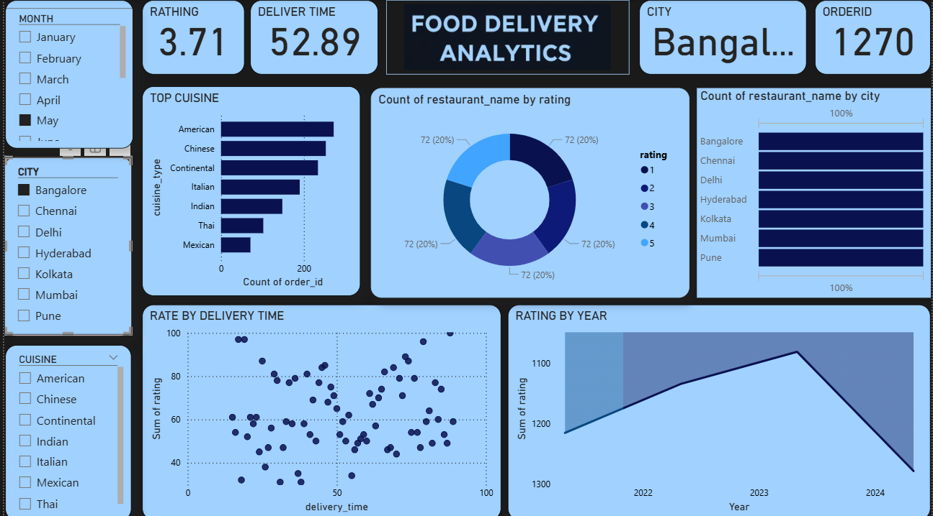

Slide 3
Introduction:
This Food Delivery Analytics dashboard is created to understand how a food delivery business is performing. It shows information about orders, delivery time, customer ratings, cities, restaurants, and cuisines in a simple visual format. The dashboard helps convert raw data into useful information that can support business decisions.
Dashboard Objective:
The main purpose of this dashboard is to:
Understand customer satisfaction
Analyze delivery time performance
Identify popular cuisines
Compare city-wise performance
Support business planning
Key KPIs Explanation
EG:Average Rating (3.71)
This shows the overall customer satisfaction. A higher rating means customers are happy with the service. A lower rating means improvement is needed.

Slide 4
Average Delivery Time (52.89 minutes)
This shows how much time, on average, food takes to reach customers. If delivery time increases, customer ratings may decrease.
Total Orders (1270)
This shows the total number of orders placed based on the selected filters.
City (Bangalore)
All dashboard data is currently filtered for Bangalore city.
Filters Used
The dashboard uses filters to make analysis easy:
Month filter to check monthly trends
City filter to compare different cities
Cuisine filter to analyze customer food preferences
Visuals Explanation
Top Cuisine Chart
This chart shows which cuisines are ordered the most. American and Chinese cuisines have more orders, while Mexican and Thai cuisines have fewer orders.

Slide 5
Rating Distribution Chart
This chart shows how many restaurants fall under each rating category from 1 to 5. It shows mixed customer experiences.
Restaurant Count by City
This chart shows how many restaurants are available in each city. Some cities have more restaurants than others.
Rating vs Delivery Time
This chart shows that when delivery time is less, ratings are higher. When delivery time is more, ratings reduce.
Rating by Year
This chart shows how ratings change over different years. Ratings improved in one year but dropped in the next, showing the need for improvement.
Overall Insights
Faster delivery leads to better ratings
Some cuisines are more popular than others
Cities with more restaurants get more orders
Delivery time affects customer satisfaction

Slide 6
Business Use
This dashboard helps:
Improve delivery speed
Focus on popular cuisines
Increase customer satisfaction
Make better business decisions
One-Line Explanation for Viva
“This dashboard shows food delivery performance by analyzing orders, delivery time, ratings, cuisines, and city-wise data using Power BI.”
--END--

